Slide 1

Representation Powers
and
Mandates
RPaM
DIGIT
3rd Working Group Meeting
21st February 2019

Slide 2

Agenda
RPaM Working Group Meeting #3
Content
Round Table
Work done:
MS and RPaM mapping
Model stabilisation
Work ongoing:
Issue threads
XML syntax binding (UBL-2.3)
Documentation
New challenges:
Service Report
IRCs
PUCs
Requests to the WG (reminder)
Questions to the WG members
7. Next WG meeting
Other questions and suggestions

Slide 3
1
Round
Table

Slide 4


1
Round Table
DIGIT and MS
everis team
European Commission
Miguel Álvarez-Rodríguez (DIGIT, project owner)
Frédéric Poels (DIGIT, project owner)
Carlos Gómez-Muñoz (DG CNNECT, project owner)
Valentin Mesaros (DIGIT, analyst)
Member States and Stakeholders in previous meetings:
MS →AT, BE, CZ, ES, FI, GR, HU, LU, NL, SI, SK, other?
Stakeholders → SEMPER, TOOP, other?
everis
Virginia Gomáriz (client manager)
Rui Venâncio (project manager)
Enric Staromiejski (eGovernment and interoperability)
Laia Bota (semantics analyst)
Danae Djin Ah Armelle Desplanques (business analyst)
Jade Maana (developer)

Slide 5
2
Work
done

Slide 6
2
Work done: model stabilisation
Mapping the MS information Requirements to the RPaM Ontology:
AT and ES completed
The rest….no models made available
Taxud is being proposed to be taken on board
Conceptual Model evolution. Inputs from AT and ES have improved and enriched the models of
Mandate
Request
Response
Agent
OWL-DL-Turtle syntax-binding:
Re-drafting of the T-Box
Example datasets
Example SPARQL queries

Slide 7
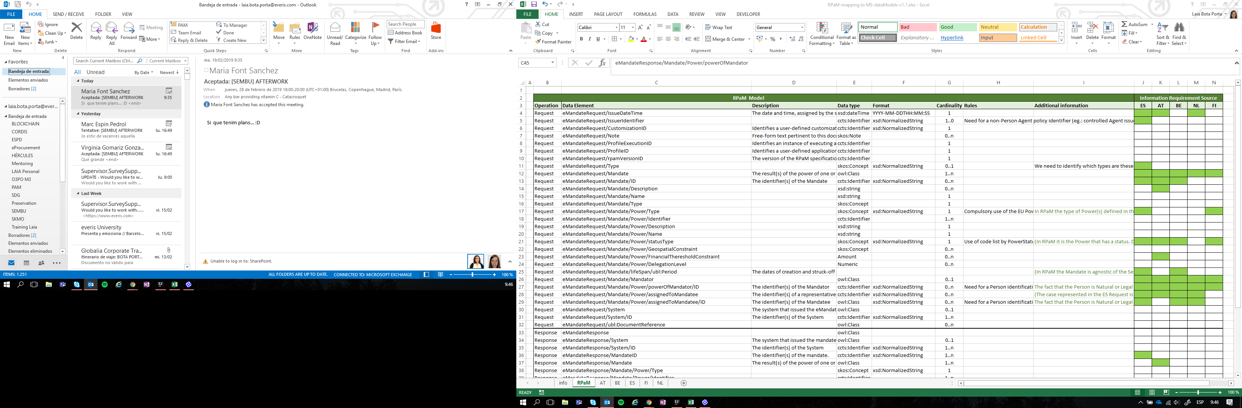
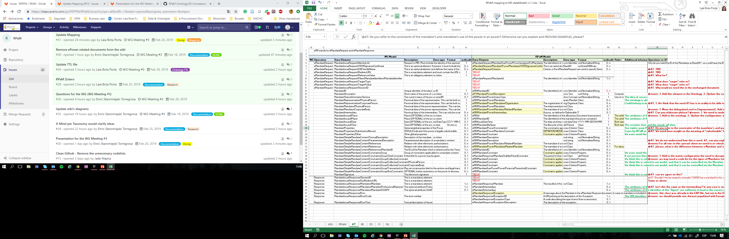
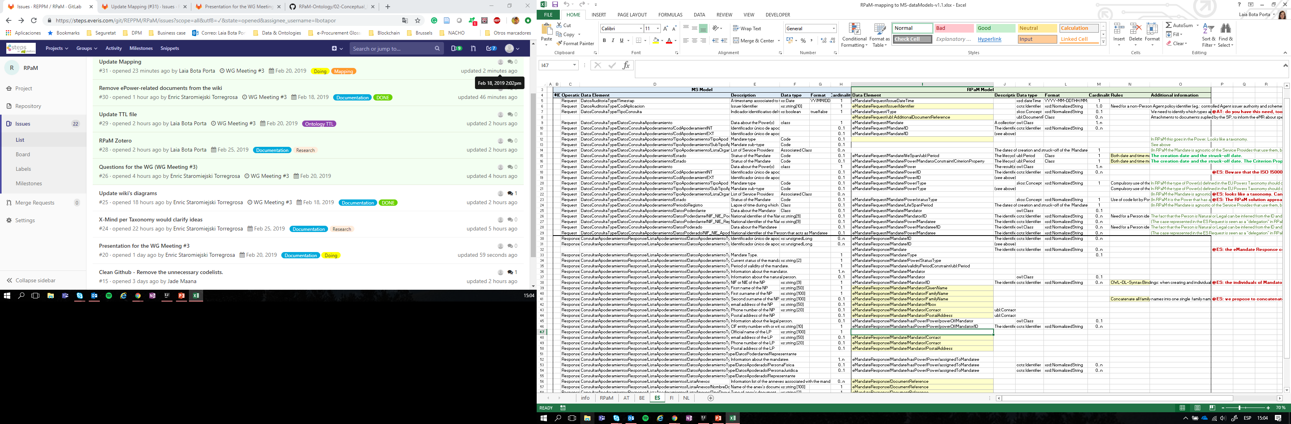
2.1
Work done: MS and RPaM mapping
Bilateral discussions held with AT and ES.
We’d like to have similar bilateral discussions with FI, BE, NL and PT → let’s organise a phone call, please: rpam-wg@everis.com

Slide 8
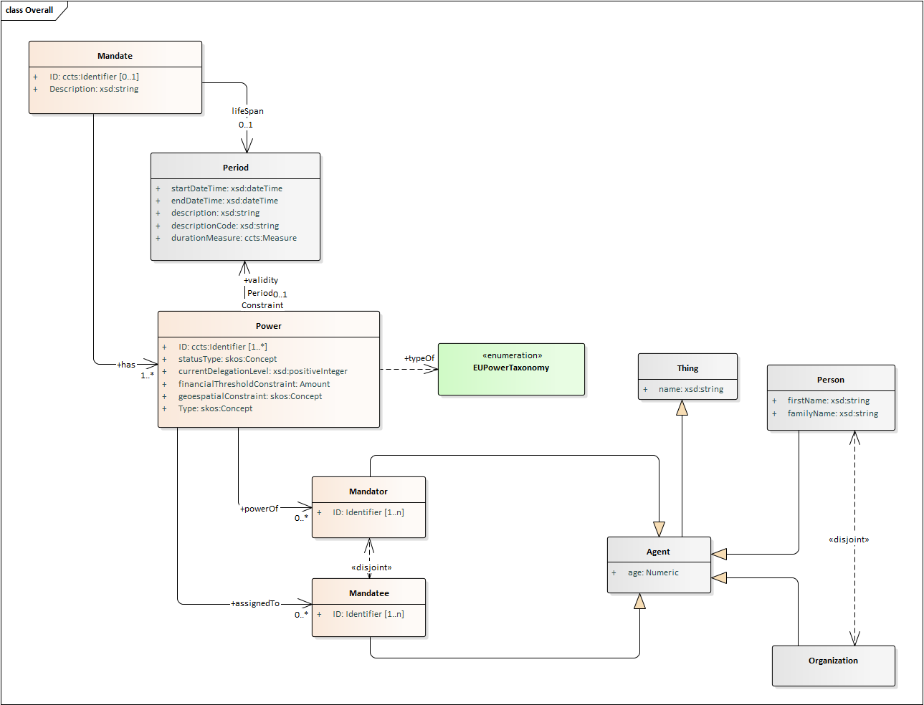
2.2
Work done: model stabilisation (previous mandate)
previous
EAP file

Slide 9
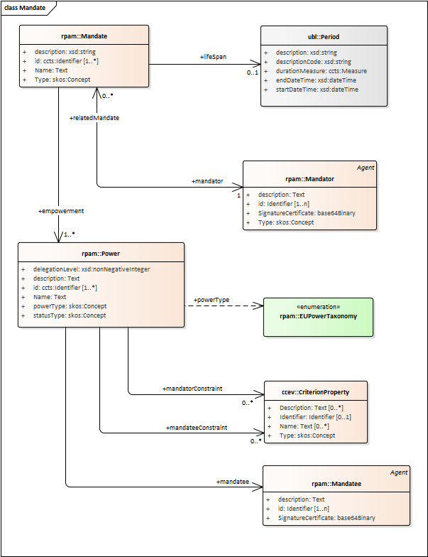
2.2
Work done: model stabilisation (current mandate)
current
EAP file

Slide 10
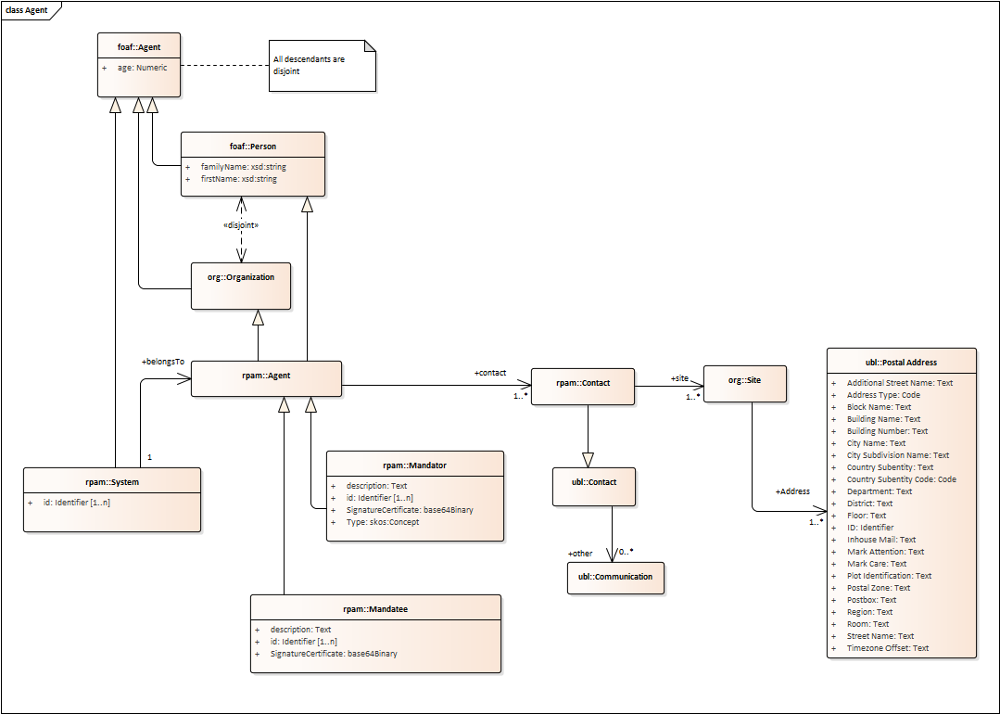
2.2
Work done: model stabilisation (agent)
current
new!
EAP file

Slide 11
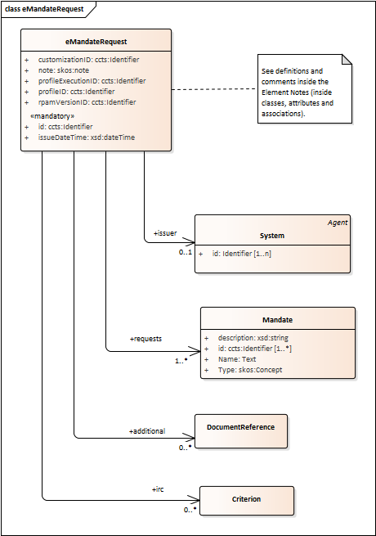
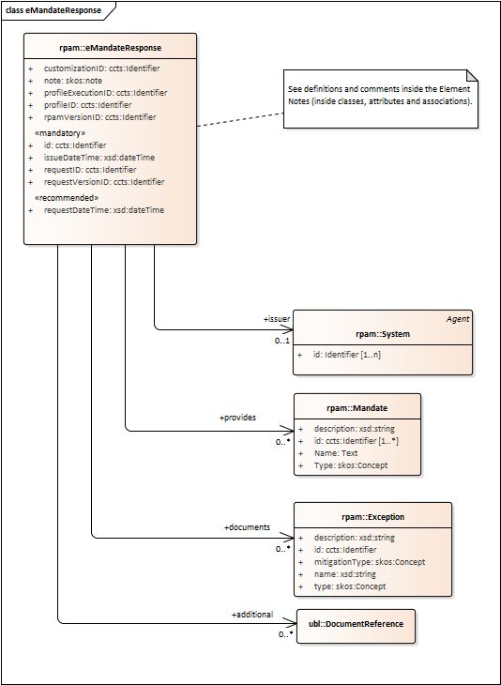
2.3
Work done: model stabilisation (transaction docs)
current
new!
EAP file

Slide 12
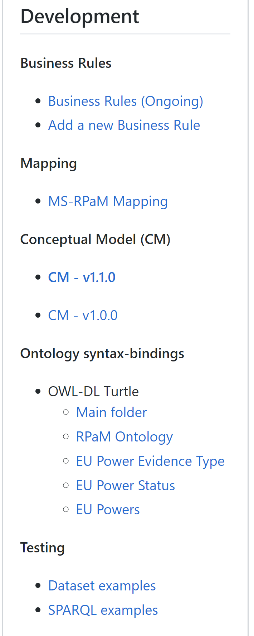
2.2
Work done: model stabilisation (OWL-DL-Turtle)
GitHub Wiki Menu
T-Box and thesauri
Test datasets and queries

Slide 13
3
Work
ongoing

Slide 14
3
Work ongoing
Issues created up to now have provided valuable input that is being analysed and discussed with the WG members.
XML design and syntax-binding is being initiated.
Documentation is being progressively drafted via small “articles” about RPaM topics (one publish, other in preparation).

Slide 15
3.1
Work ongoing: Issue threads
Examples of feed-back with impacts on the RPaM model:
Issue #1, triggers new challenges
→ need for IRCs and PUCs (explained later).
Issue #4, current discussion and analysis on how to apply the eIDAS identifier policy for the eAuthorisation of representatives of natural and legal persons
→ (work ongoing).
Issue #5, puts forward a new challenge, too
→ need of a “Service Report” (explained later).
Issues #8 and 9, SEMPER feed-back
→ improves notably the RPaM glossary (alignment to SEMPER).

Slide 16
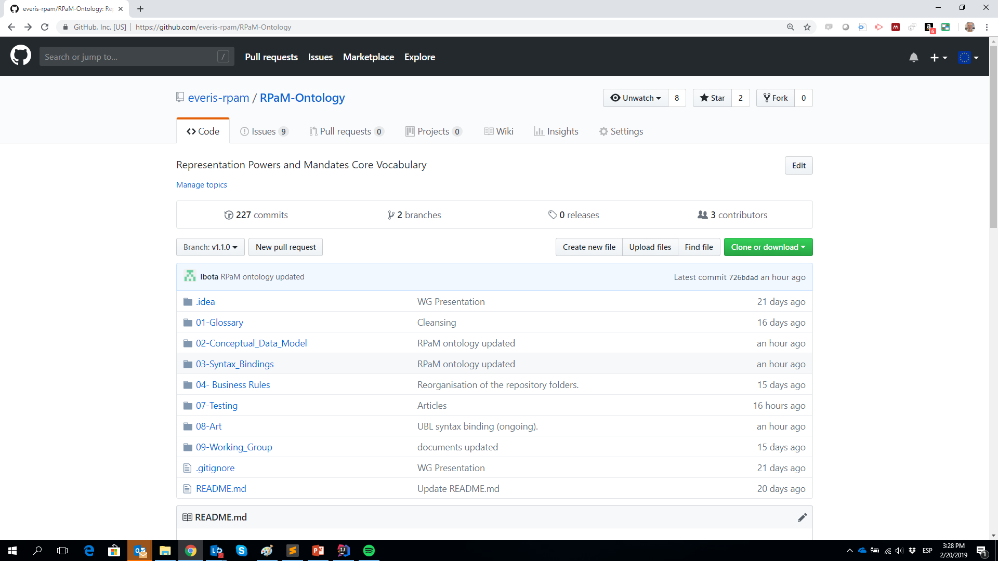
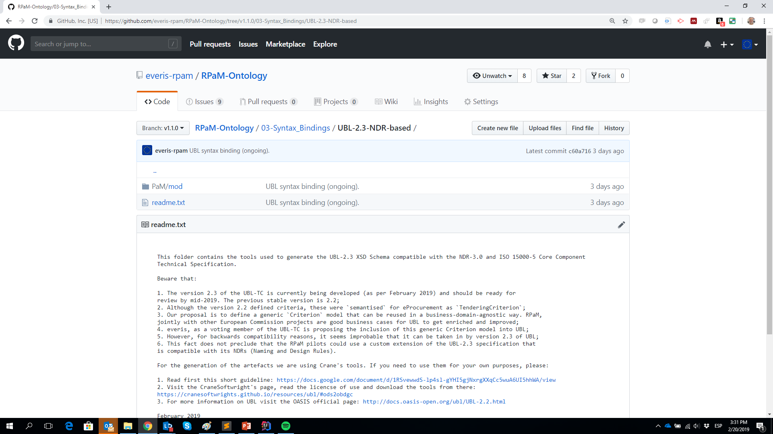
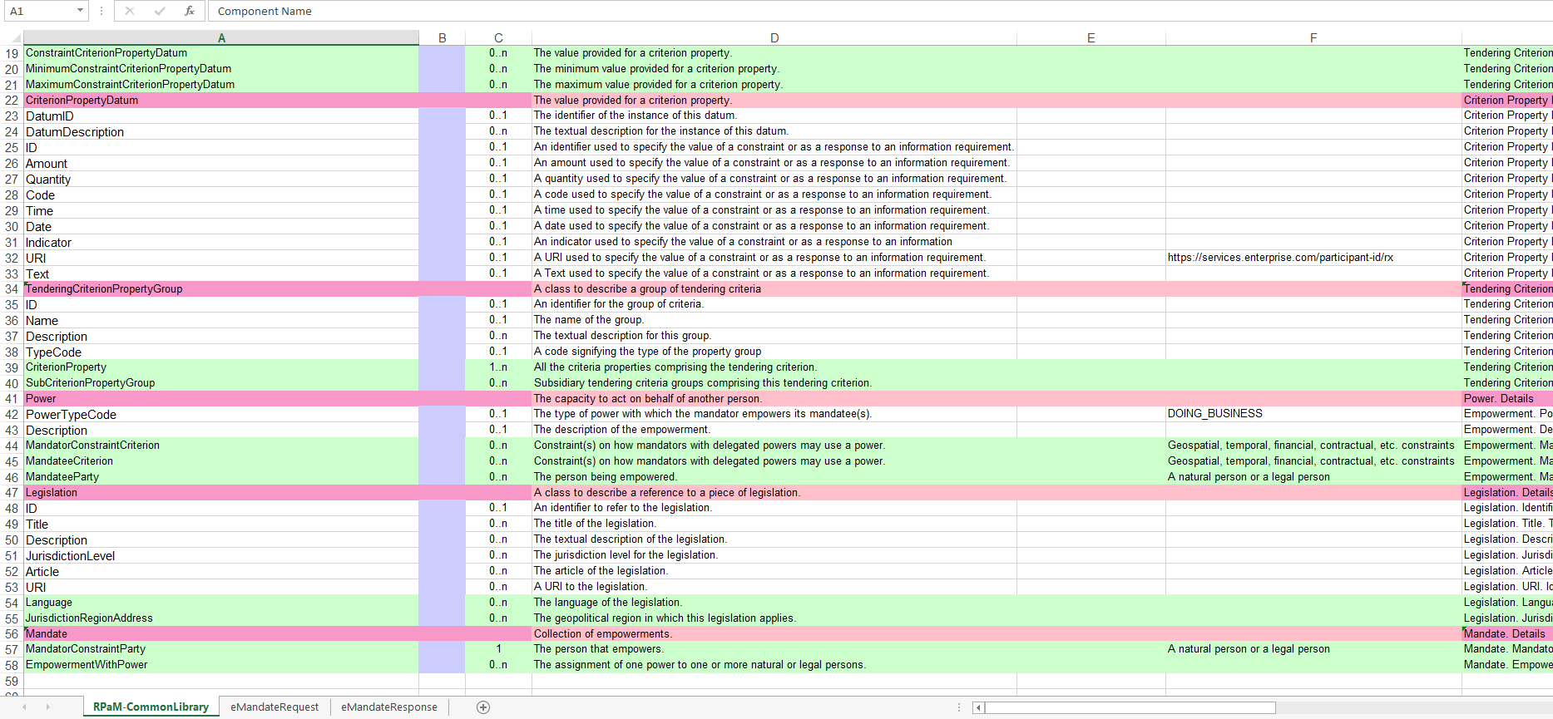
3.2
Work ongoing: XML Syntax binding
We have re-structured the code repository folder structure
We have started converting (automatically) the RPaM data model into UBL-2.3 NDR-conformant syntax
In the next weeks we’ll provide example XML instances of eMandateRequest, eMandateResponse expressed as UBL-2.3
The final deliverables will include two syntax bindings:
OWL-DL-Turtle (for data integration and user-friendly documentation purposes), and
UBL-2.3 XML artefacts (for real transactions)

Slide 17
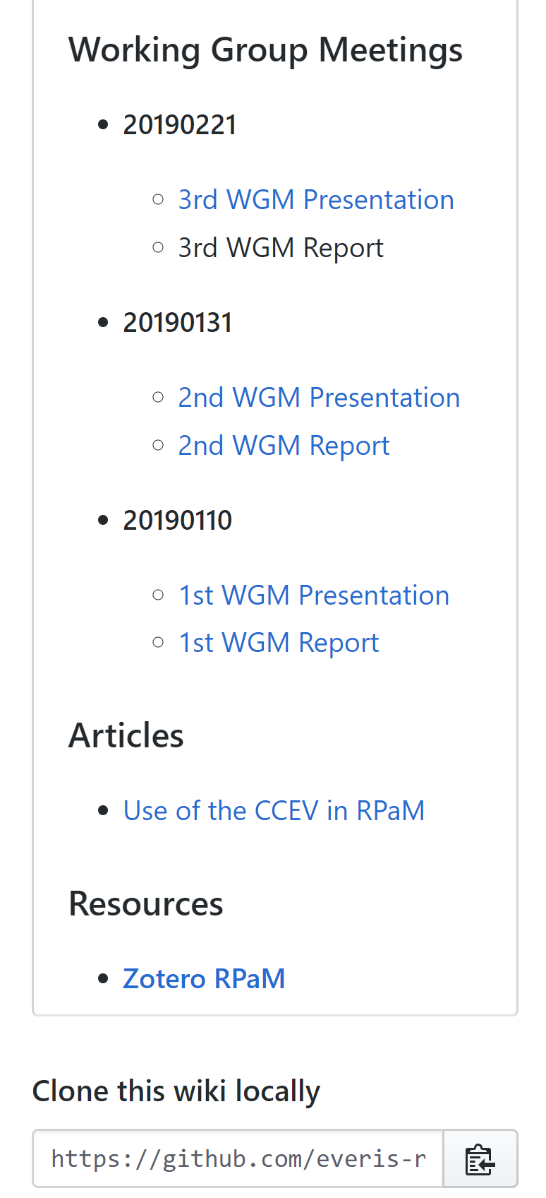
3.3
Work ongoing: documentation
Ongoing bits and pieces (articles, references, diagrams, etc.)
GitHub Wiki Menu
RPaM Topics
Bibliographic resources

Slide 18
4
New challenges

Slide 19
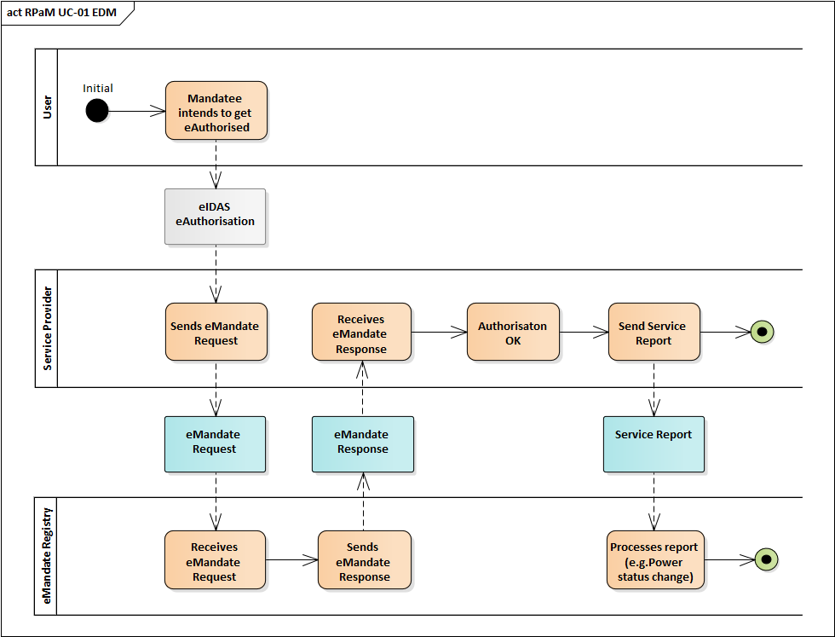
4.1
New challenges: Service Report
The discussions on the issues have also raised possible new transactions, e.g. do we need for a “Service Report” for notifications back to the eMandate Registry?

Slide 20
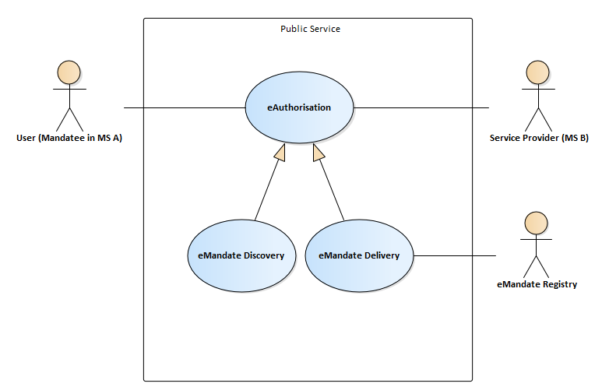
4.2
New challenges: IRCs (Information Requirements and Constraints)
The situation
Reminder: focus On UC “Cross-Border eAuthorisation”.
In principle, every data necessary for this UC is
expected in the Mandate.
However, Services may need to be provided with data
that the Mandate cannot contain or foresee.
This should not be the case for “harmonised Services”.
The RPaM ontology, though, has to provide the possibility for non-harmonised Services of specifying its own “information requirements” (and constraints on them).
Hence, as specific information requirements may be unknown beforehand:
The Service needs to be able to communicate the eMandate Registry which are these specific information requirements;
The eMandate Registry needs to be able to provide the data required in the Response.
MS-X

Slide 21
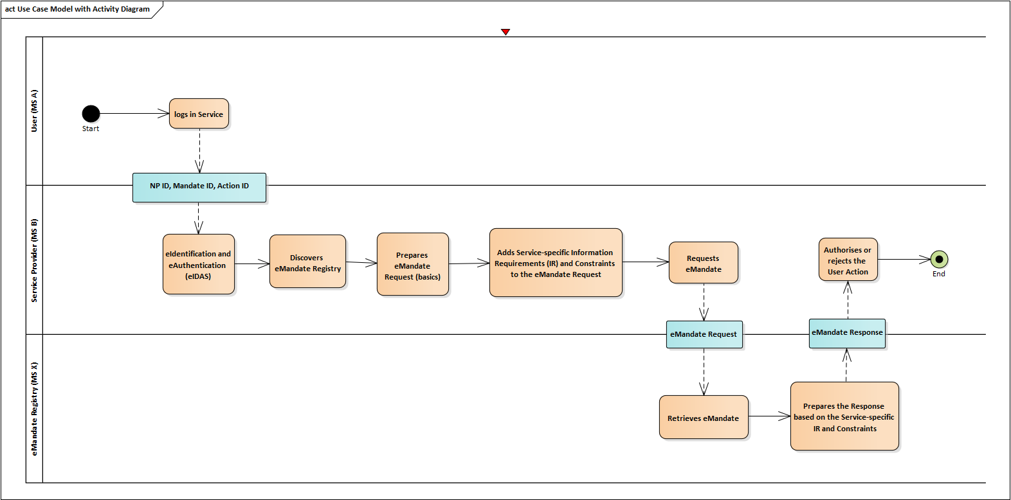
4.2
New challenges: IRCs (Information Requirements and Constraints)
Simplified flow view:

Slide 22
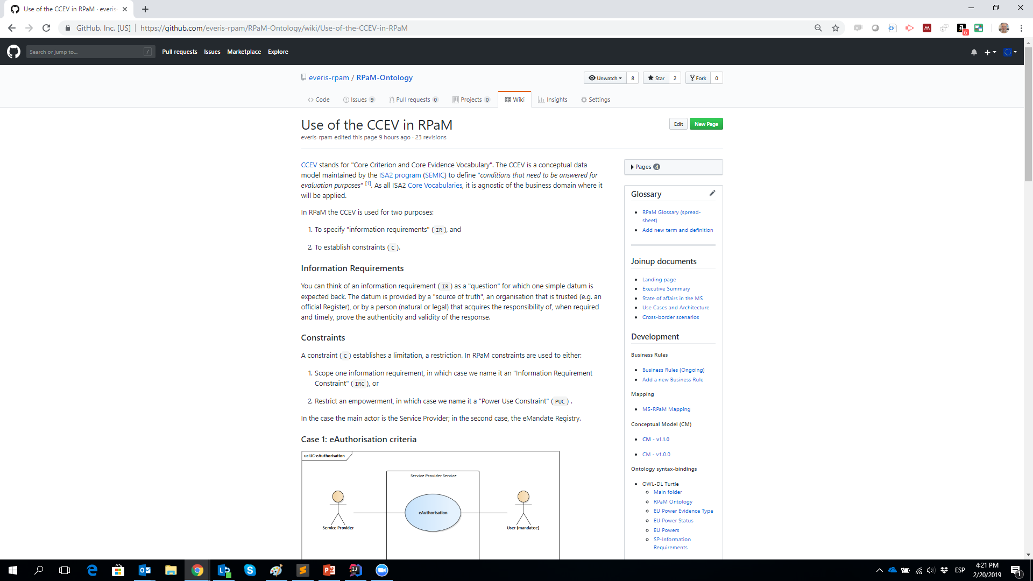
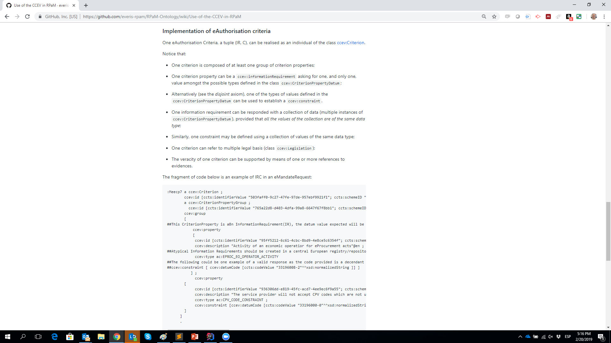
4.2
New challenges: IRCs (Information Requirements and Constraints)

Slide 23
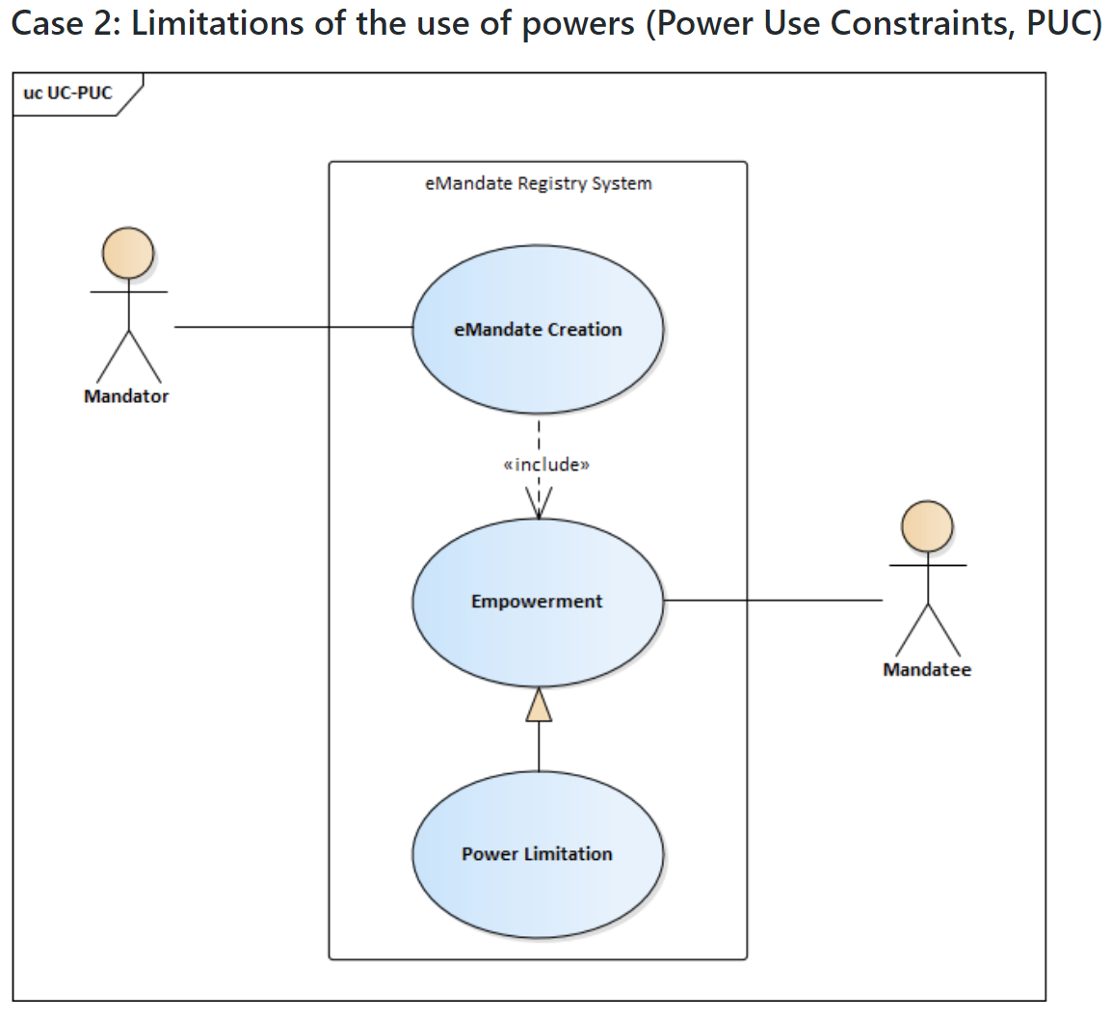
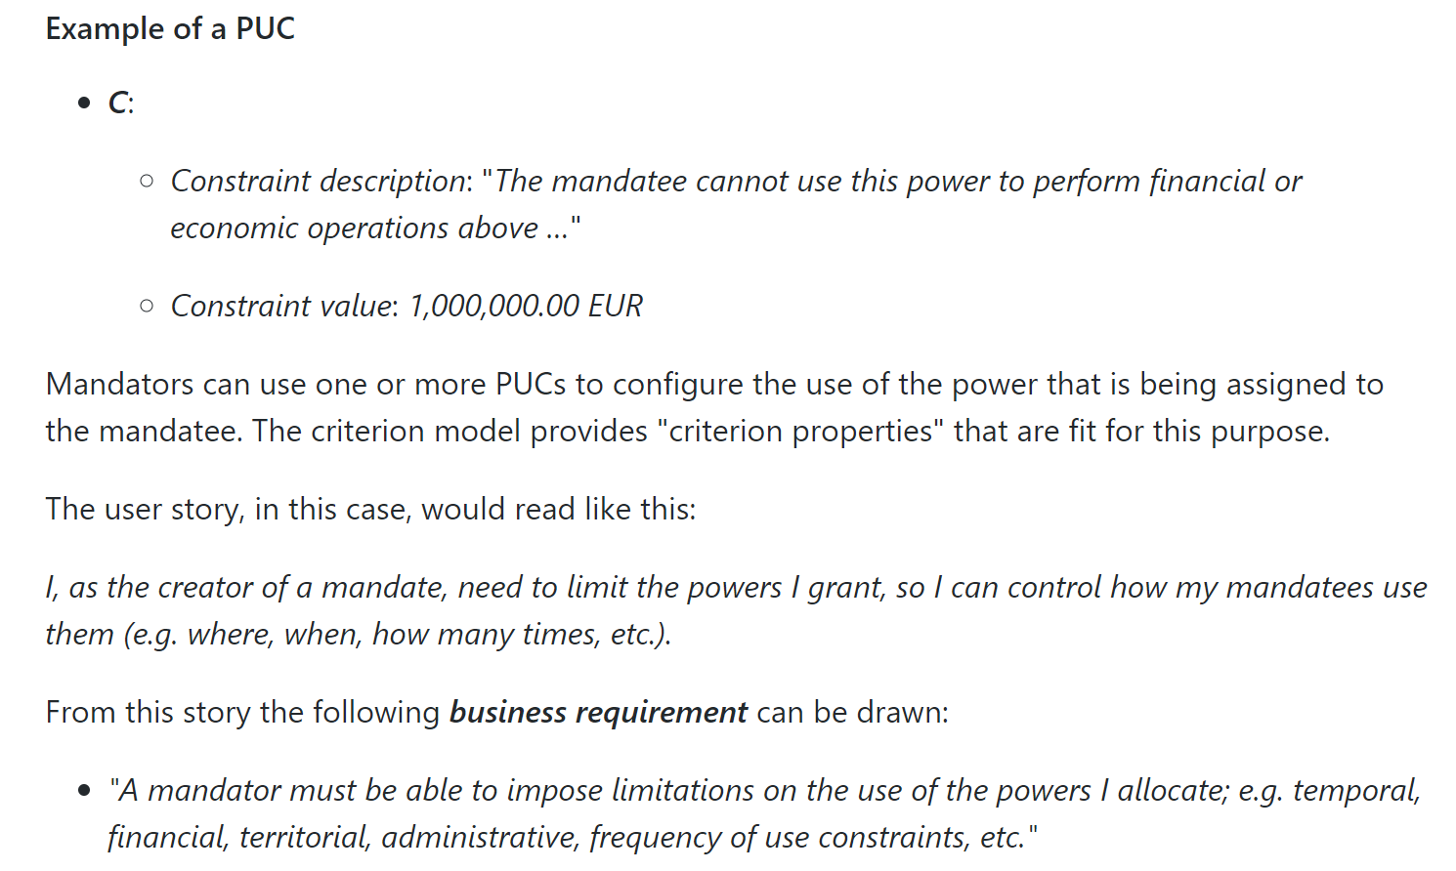
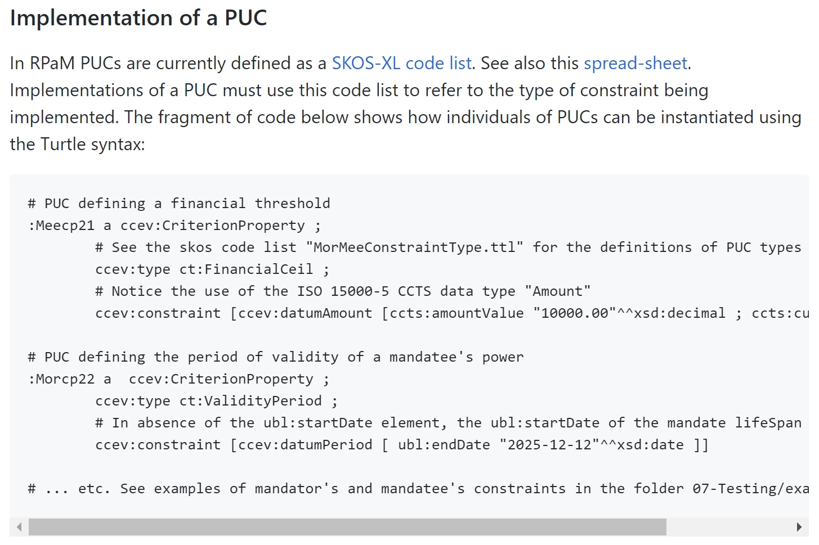
4.3
New challenges: PUCs (Power Use Constraints)
https://github.com/everis-rpam/RPaM-Ontology/wiki/Use-of-the-CCEV-in-RPaM

Slide 24
5
Requests to the WG

Slide 25
5
Requests to the WG members
Please:
Check that the new proposals cover your needs and requirements.
Use the GitHub Issues to start new threads of discussion.
Use the everis-rpam@everis.com email to organise bilateral phone conversations.
Provide us with Mandate, Request and Response instance samples (the more the better).
Provide us with CODE LISTS and TAXONOMIES used in your countries in the context of Representation Powers and Mandates.

Slide 26
6
Questions
to the WG

Slide 27
6
Questions to the WG members (1/2)
Synergies with SEMPER, how can RPaM cooperate?
Does versioning the mandate content make sense? This could be needed when the status of a power in a mandate changes.
Do we need a kind of "ServiceReport" document to notify the eMandate Registry about how the use of a mandate went?

Slide 28
10
Questions to the WG members (2/2)
One or more Issuer System in the Request and Response:
"Right now we propose to have an "Issuer" System. But a more flexible solution could be to have 1..n Systems involved in the transaction.
Additionally each System could have two properties: role (e.g. creator, mediator, issuer, etc.) and an ordinal number to identify the participation of each system in the transaction creator → 0, mediator1→ 1, mediator2 → 2, issuer-3, thus creating a chain of systems.
Now, is this relevant to RPaM, or this an "internal" affair of the MS that issues the document?

Slide 29
Next
WG
meeting
7

Slide 30
7
Next WG meeting
14th March 10 a.m. (in three weeks)

